Slide 1
The S. S. Debbie
By
Ashley, Julianna, and Nino

Slide 2
Jobs
Ashley- Designer
Julianna- Procedure
Nino- Folder Organizer and Calculator

Slide 3
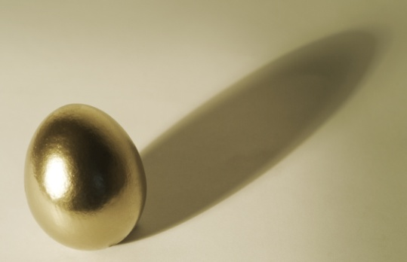
SCIENTIFIC METHOD
How long will the rocket stay up for?
Air Rocket- 1.85 seconds Water Rocket- 3.78 seconds
Will the egg survive?
Yes, both times(:

Slide 4
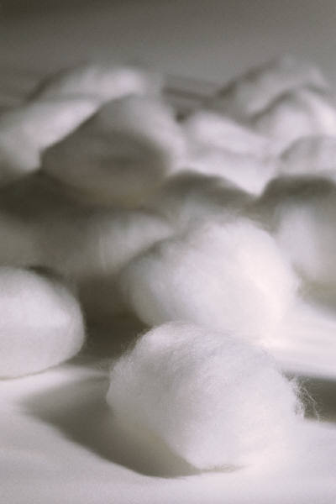
Materials
Cotton balls
Pillow Fluff
Construction Paper
Duct tape
Masking tape
Coke soda bottle

Slide 5
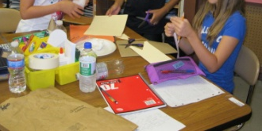
Building Procedure
First we got the coke bottle.
Next brought materials we needed.(cotton balls and construction paper)
After that we finally started to build.
We used a paper plate Mrs. Simmons gave us and started to make the nose cone.
After that we made the fins with Ashley’s construction paper in a triangle.
Then we made the base of the cone with more of her construction paper.
We traced the bottom of the cone.
Then we put cotton balls in the nose cone to keep the egg cozy.
Then we used Mrs. Simmon’s pillow fluff and glued it onto the base.
After that we made an opening and closing with duct tape.
Also we taped the whole thing together with the duct tape.

Slide 6
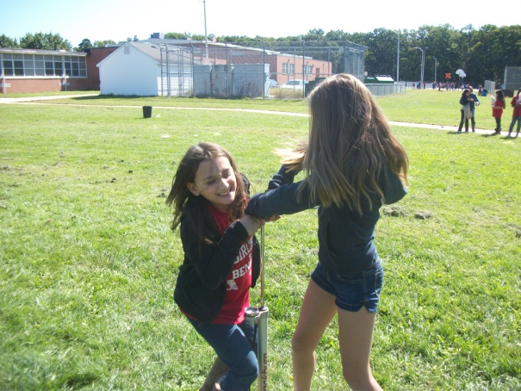
Launching Procedure
First we put duct tape on the nose cone.
Then we hooked it up to the launch station.
Then Ashley and I started to pump the pump.
When it got to 80 psi we stop pumping.
Then the count down began.
Then Nino pulled the string to make the rocket fly.

Slide 7
Hypothesis/Prediction
Prediction:
We predict that the air rocket will 4.00 second. We also imagine very high! We also predict that it will be partly sunny or rainy.
Answer:
The air rocket stayed up for 1.85 seconds. It did go very high and it was sunny.

Slide 9
Comparison
Both, in the air launch and water launch we used air in both also we used the same materials. Another thing that’s the same is we used 80% of pressure for each one. One more thing is that both of the eggstronauts survived and both went in the air.

Slide 10
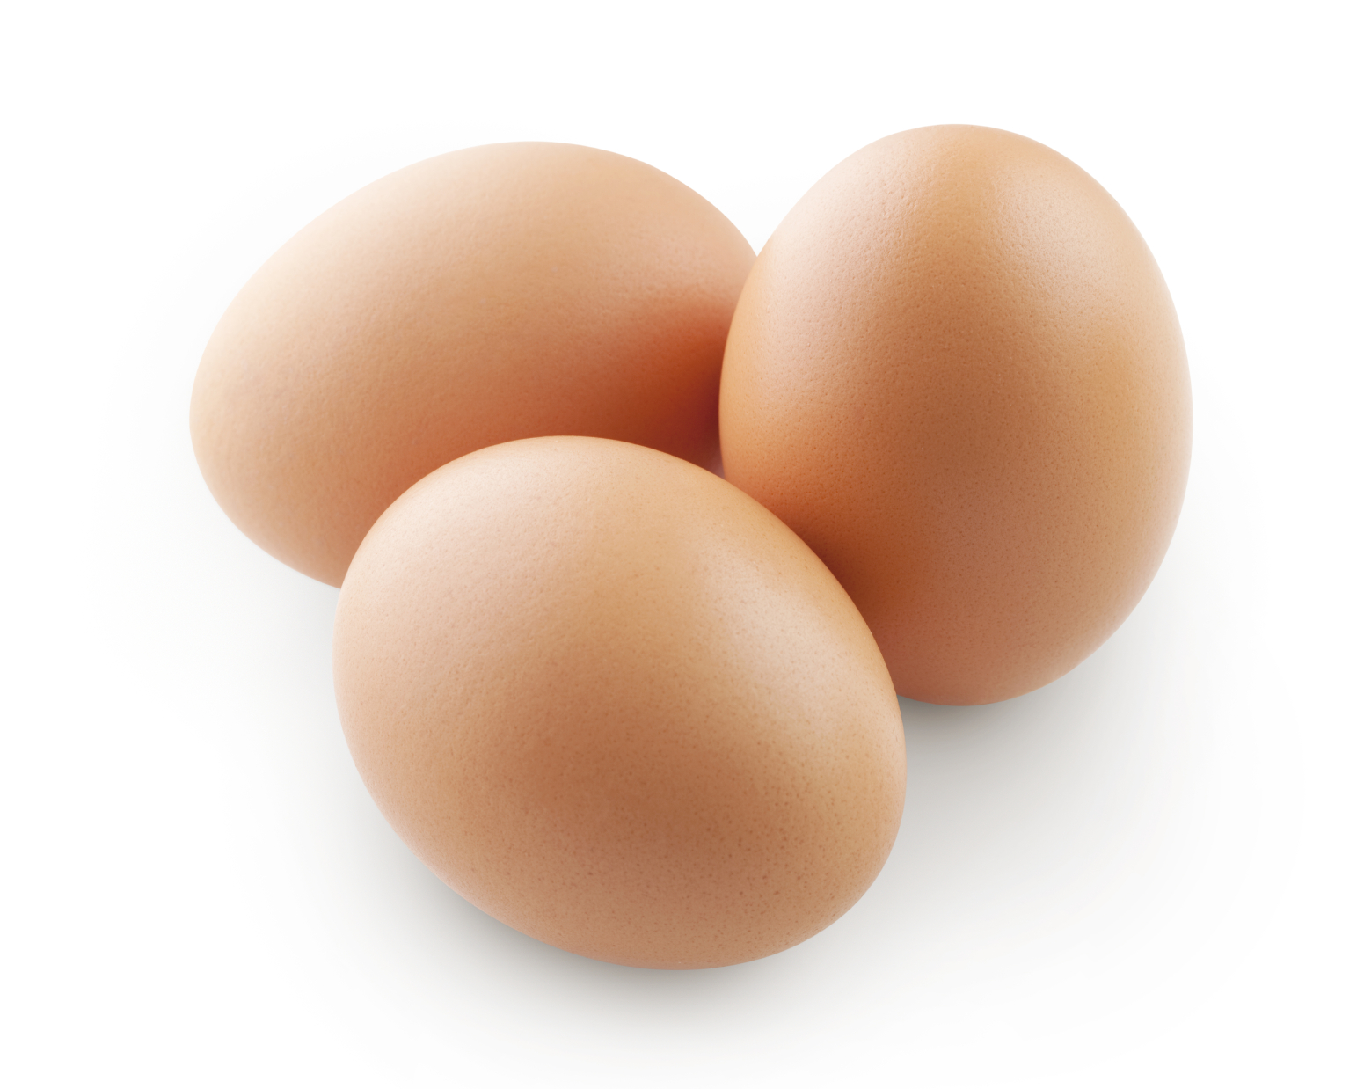
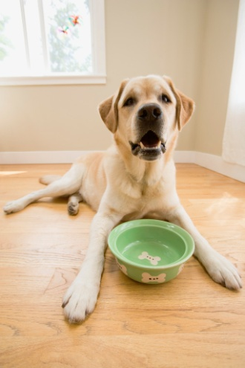
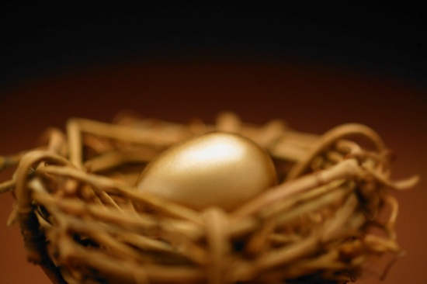
Eggstronaut
Our eggstronaut was named Debby dog for the water rocket and for the air rocket her name was Debby. Debby was awesome and she survived!(:

Slide 11
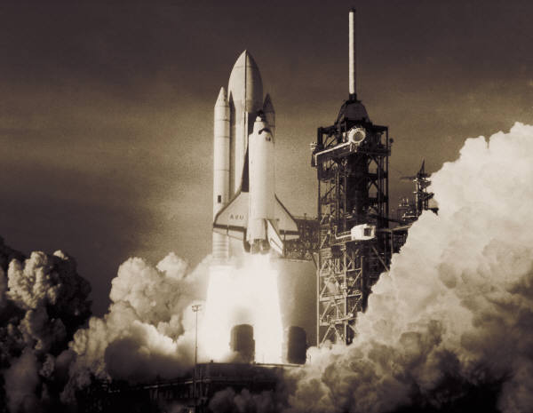

ROCKETS!

Slide 12
THE EXPERIENCE
As soon as we launched our rocket it went high and we felt like we would cry tears of joy! As soon as it landed all three of us ran to the rocket… DEBBY WAS ALIVE!!!!!!! We were so enthusiastic and Mrs. Simmons took our picture.

Slide 13
NASA
At first we met NASA scientist, Mr. Tom Benson. He taught us what we would need and he was our inspiration. He really helped us.

Slide 14

The End

